Slide 1



UNIVERSITY OF SCIENCE AND TECHNOLOGY OF HANOI
HTTP OVER MPI
COURSE: DISTRIBUTED SYSTEMS
LECTURER
Mr. Le Nhu Chu Hiep
LEADER
Pham Hoang Viet
MEMBERS
Nghiem Xuan Son
Vu Xuan Thai
Hoang Minh Quan
Pham Huu Minh
Nguyen Ngoc Quang
Tran Vu Cong MInh
Let's Get Started

Slide 2
CONTENT
INTRODUCTION
&OBJECTIVE
SYSTEM ARCHITECTURE
SYSTEM OVERVIEW
IMPLEMENTATION
KET TECNOLOGIES
DEMO&RESULT
CONCLUSION

Slide 3
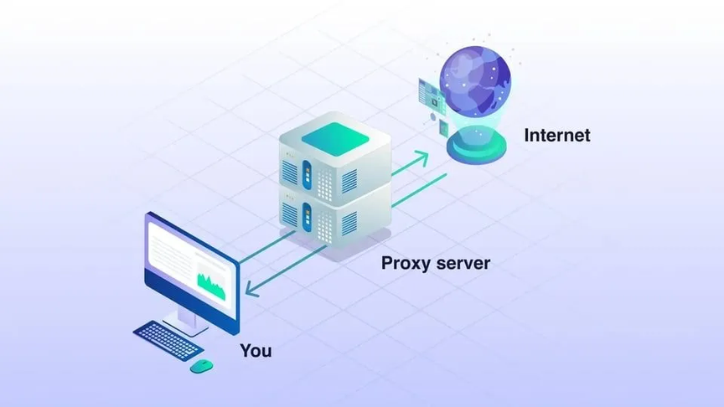
INTRODUCTION&OBJECTIVE
Objective:
Build a system to send HTTP requests from a Client through an intermediate Proxy
Core Technologies:
Uses MPI protocol for internal communication and Libcurl library for Internet communication
To demonstrate how High-Performance Computing (MPI) can integrate with Web Protocols (HTTP).

Slide 4
SYSTEM OVERVIEW
The system operates according to the SPMD (Single Program, Multiple Data) model with 2 main processes:
Rank 0 (Client): Handles user input and displays the final result.
Rank 1 (Proxy): Acts as a gateway to the Internet.
Workflow: Client ↔ (MPI) ↔ Proxy ↔ (HTTP) ↔ Internet

Slide 5

KEY TECHNOLOGIES
MPI ((Message Passing Interface):
Standard for parallel computing.
Functions: MPI_Init, MPI_Send, MPI_Recv, MPI_Comm_rank.
Libcurl (Client URL Library):
A free and easy-to-use client-side URL transfer library.
Functions: curl_easy_init, curl_easy_setopt, curl_easy_perform.

Slide 6
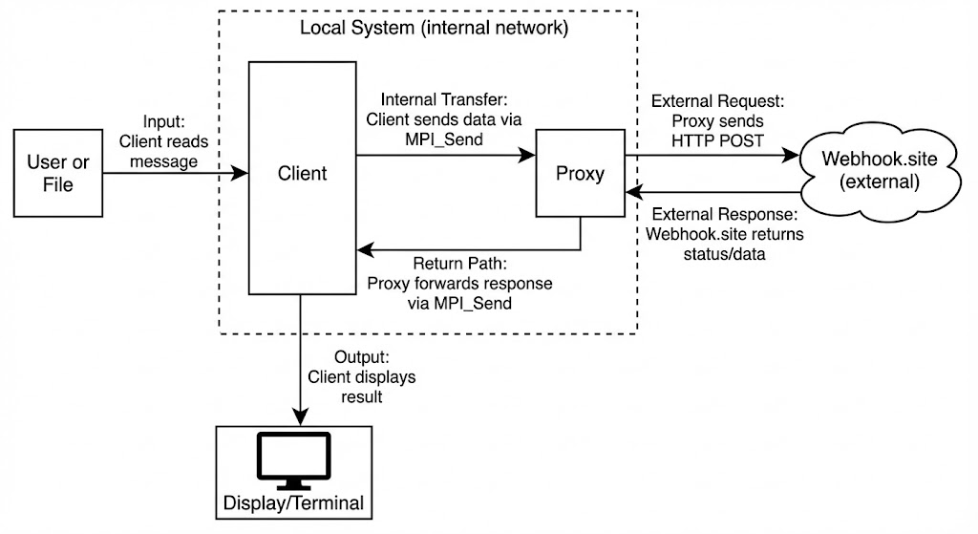
SYSTEM ARCHITECTURE
Data Flow
Input: Client reads "message" from User or File.
Internal Transfer: Client sends data to Proxy via MPI_Send.
External Request: Proxy sends HTTP POST to Webhook.site.
External Response: Webhook.site returns status/data.
Return Path: Proxy forwards response to Client via MPI_Send.
Output: Client displays the result.

Slide 7
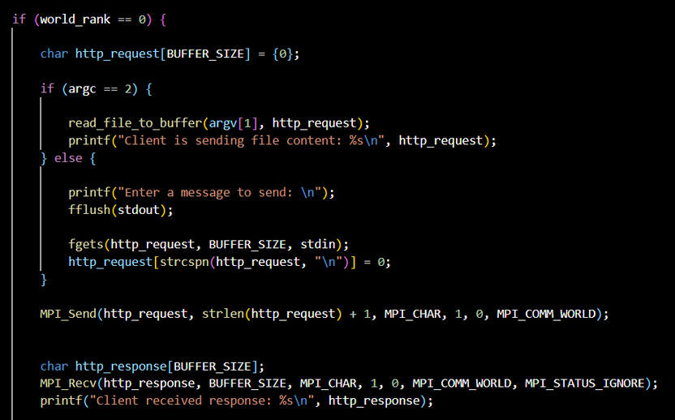
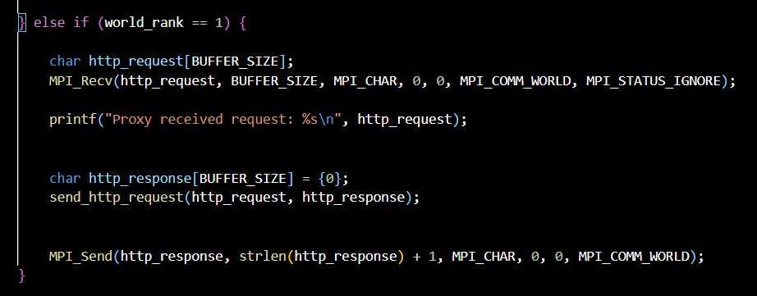
IMPLEMENTATION LOGIC
Rank 0 (client)
Rank 1 (proxy)

Slide 8
DEMO (kali Linux)
nano http_proxy_mpi.c
Create&edit file
mpicc http_proxy_mpi.c -o http_proxy_mpi -lcurl
Complie command
mpirun --allow-run-as-root -np 2 ./http_proxy_mpi
Run Command

Slide 9
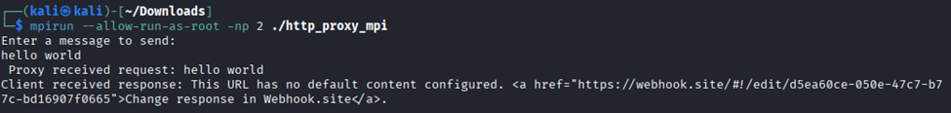
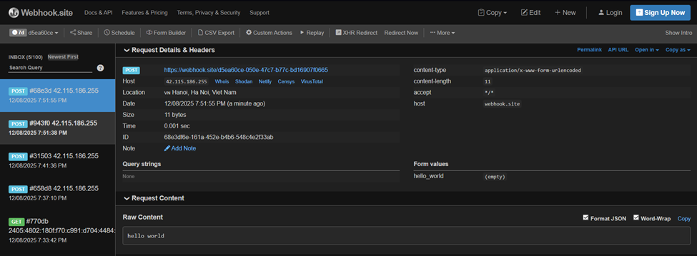
RESULT

Slide 10

CONCLUSION
Successfully implemented a hybrid communication system (MPI + HTTP).
Resolved critical memory safety issues in C.
Demonstrated reliable data transfer between parallel processes and external web servers.

Slide 11


